Slide 1
LabView Programming Update

Slide 2
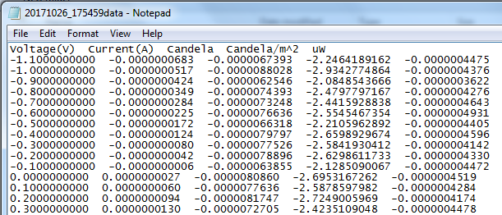
LabView Coding
No real-time feedback!

Slide 3
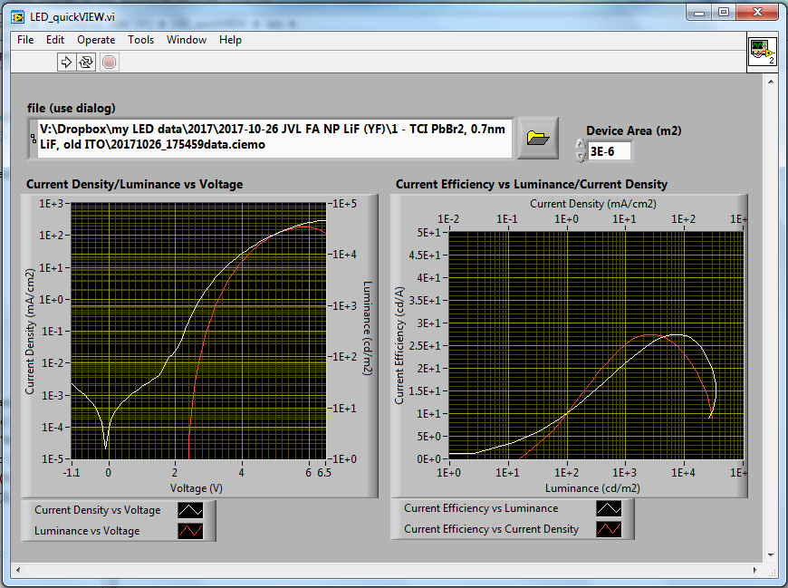
“LED_quickVIEW”
Quick view of the device characteristics!

Slide 4
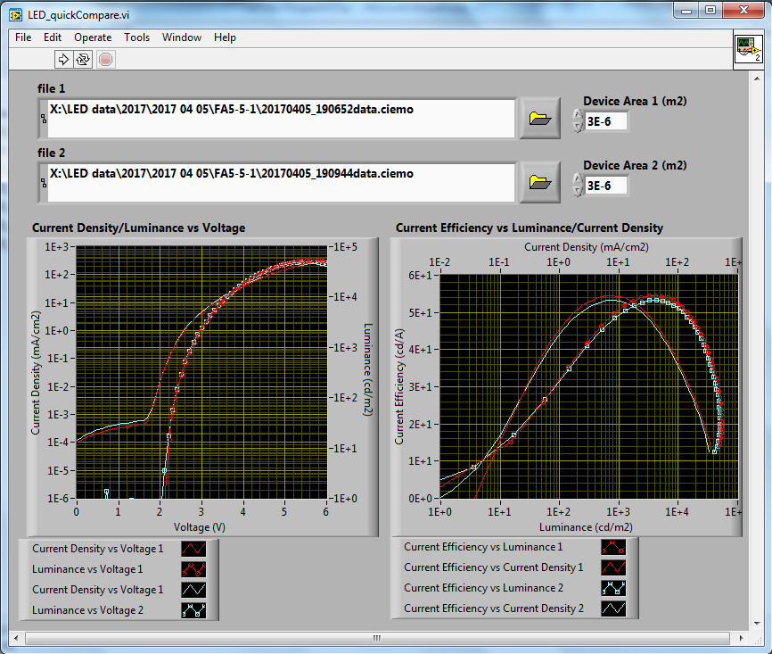
“LED_quickCompare”
Quick comparison of between two data set.

Slide 5
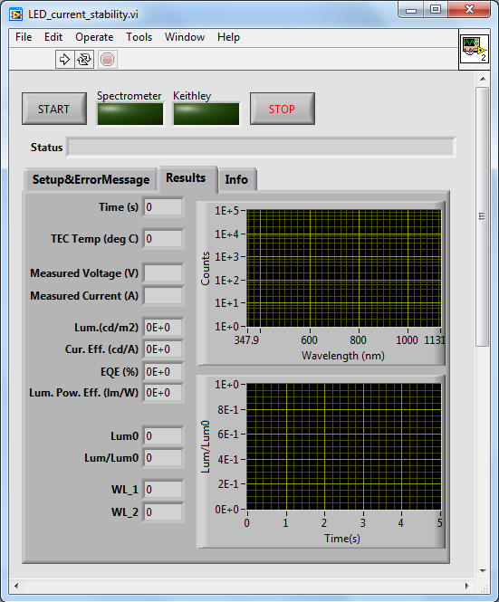
Constant Current
Measurement
completed

Slide 7
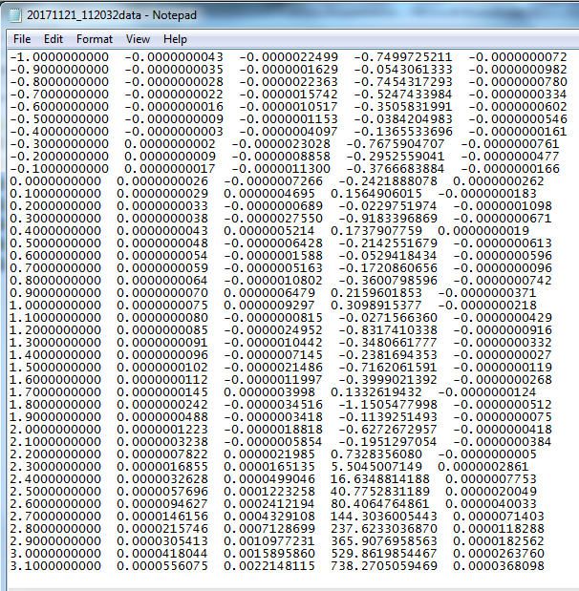
Data file do not indicate current level to apply for getting 100cd/m2 !!!

Slide 8
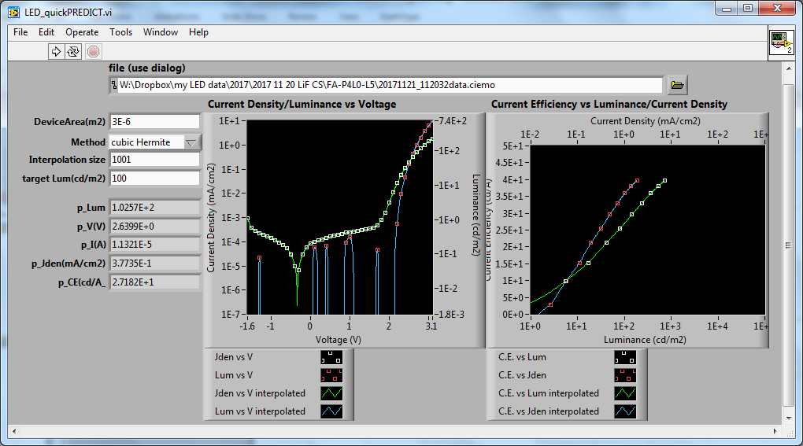
“LED_quickPredict”
Interpolate the data; providing the estimated current and voltage level to apply at the targeted luminance level.

Slide 10
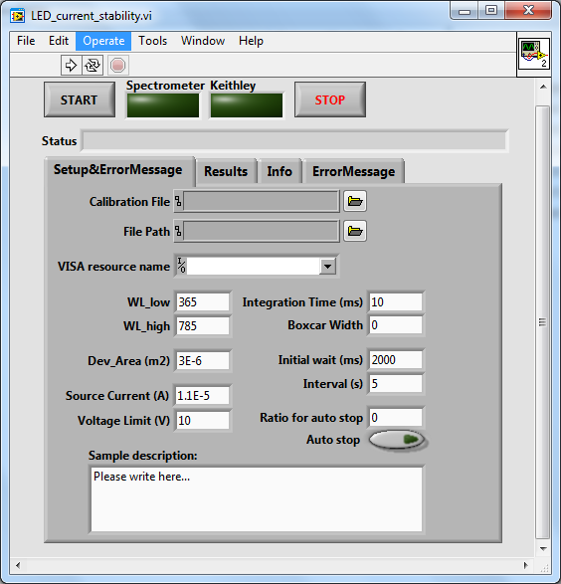
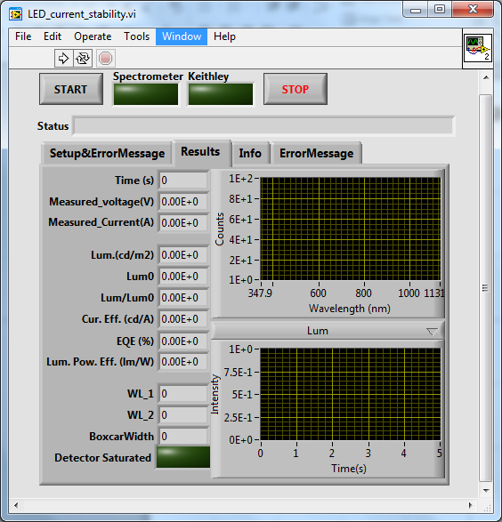
Constant Current Stability: update
Users can write down the sample conditions/description
Easy view: regroup all of the Luminance related values together.

Slide 11
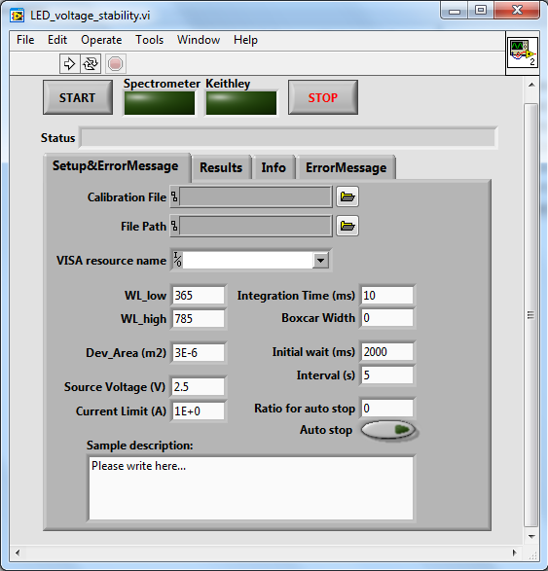
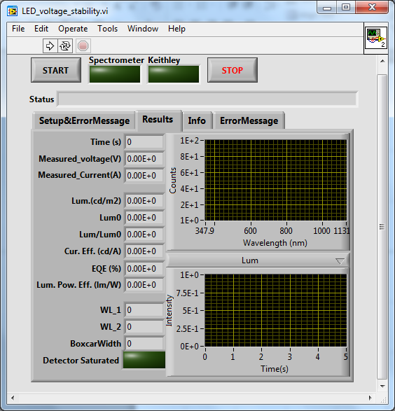
Constant Voltage Stability
Sourcing constant Voltage instead of currnet
Similar User Interface as the Constant Current Measurement Program.

Slide 13
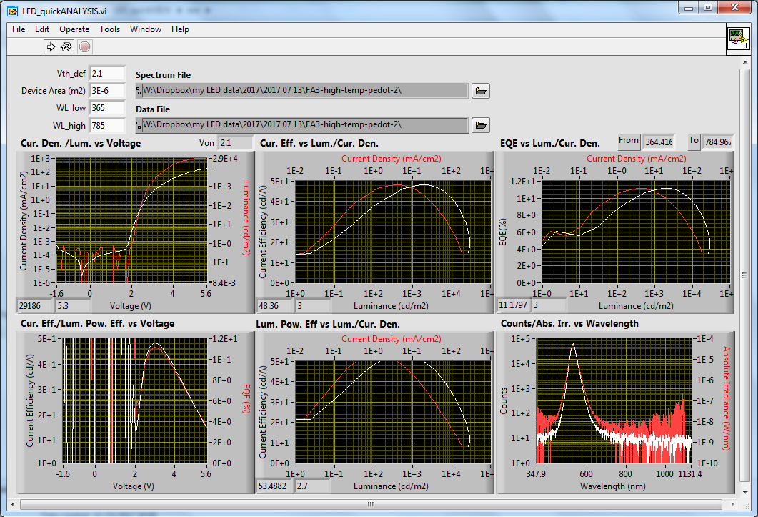
“LED_quickAnalysis”

